Slide 1
Introduction to Information Security

Slide 2
Objectives
Understand the definition of information security
Understand the critical characteristics of information
Understand the comprehensive model for information security
Outline the approaches to information security implementation
Outline the phases of the security systems development life cycle
Understand the key terms of information security
Notes:
Upon completion of this chapter you should be able to:
Understand what information security is and how it came to mean what it does today.
Comprehend the history of computer security and how it evolved into information security.
Understand the key terms and critical concepts of information security as presented in the chapter.
Outline the phases of the security systems development life cycle
Understand the role professionals involved in information security in an organizational structure.

Slide 3
Introduction
Information security: a “well-informed sense of assurance that the information risks and controls are in balance.” —James Anderson, Inovant (2002)
The practice of defending information from unauthorized access, use, disclosure, disruption, modification, perusal, inspection, recording or destruction.
Notes:
What Is Information Security?
Information security in today’s enterprise is a “well-informed sense of assurance that the information risks and controls are in balance.” –Jim Anderson, Inovant (2002)
Before we can begin analyzing the details of information security, it is necessary to review the origins of this field and its impact on our understanding of information security today.

Slide 4
The History of Information Security
Began immediately after the first mainframes were developed
Groups developing code-breaking computations during World War II created the first modern computers
Physical controls to limit access to sensitive military locations to authorized personnel
Rudimentary in defending against physical theft, espionage, and damage
Notes:
The History Of Information Security
The need for computer security, or the need to secure the physical location of hardware from outside threats, began almost immediately after the first mainframes were developed.
Groups developing code-breaking computations during World War II created the first modern computers .
Badges, keys, and facial recognition of authorized personnel controlled access to sensitive military locations.
In contrast, information security during these early years was rudimentary and mainly composed of simple document classification schemes.
There were no application classification projects for computers or operating systems at this time, because the primary threats to security were physical theft of equipment, espionage against the products of the systems, and sabotage.

Slide 5
What is Security?
“The quality or state of being secure—to be free from danger”
A successful organization should have multiple layers of security in place:
Physical security-Product the Physical items, object or areas from unauthorized access and misuse
Personal security-Protection to personal who authorized to access organization and its operation
Operations security-Protection of the details of particular operation or activities
Communications security-Protection of organizations communication media, technology and content
Network security-Protection of Networking Components, Connections and Contents
Information security-Protection of information and its Critical elements
Notes:
What Is Security?
In general, security is “the quality or state of being secure--to be free from danger.”
It means to be protected from adversaries--from those who would do harm, intentionally or otherwise.
What Is Security?
A successful organization should have the following multiple layers of security in place for the protection of its operations:
Physical security - to protect the physical items, objects, or areas of an organization from unauthorized access and misuse.
Personal security – to protect the individual or group of individuals who are authorized to access the organization and its operations.
Operations security – to protect the details of a particular operation or series of activities.
Communications security – to protect an organization’s communications media, technology, and content.
Network security – to protect networking components, connections, and contents.

Slide 6
What is Information Security?
The protection of information and its critical elements, including systems and hardware that use, store, and transmit that information
Necessary tools: policy, awareness, training, education, technology
C.I.A. triangle was standard based on confidentiality, integrity, and availability
C.I.A. triangle now expanded into list of critical characteristics of information
Notes:
What Is Information Security?
Information security, therefore, is the protection of information and its critical elements, including the systems and hardware that use, store, and transmit that information.
But to protect the information and its related systems from danger, tools, such as policy, awareness, training, education, and technology are necessary.
The C.I.A. triangle has been considered the industry standard for computer security since the development of the mainframe. It was solely based on three characteristics that described the utility of information: confidentiality, integrity, and availability.
The C.I.A. triangle has expanded into a list of critical characteristics of information.

Slide 7
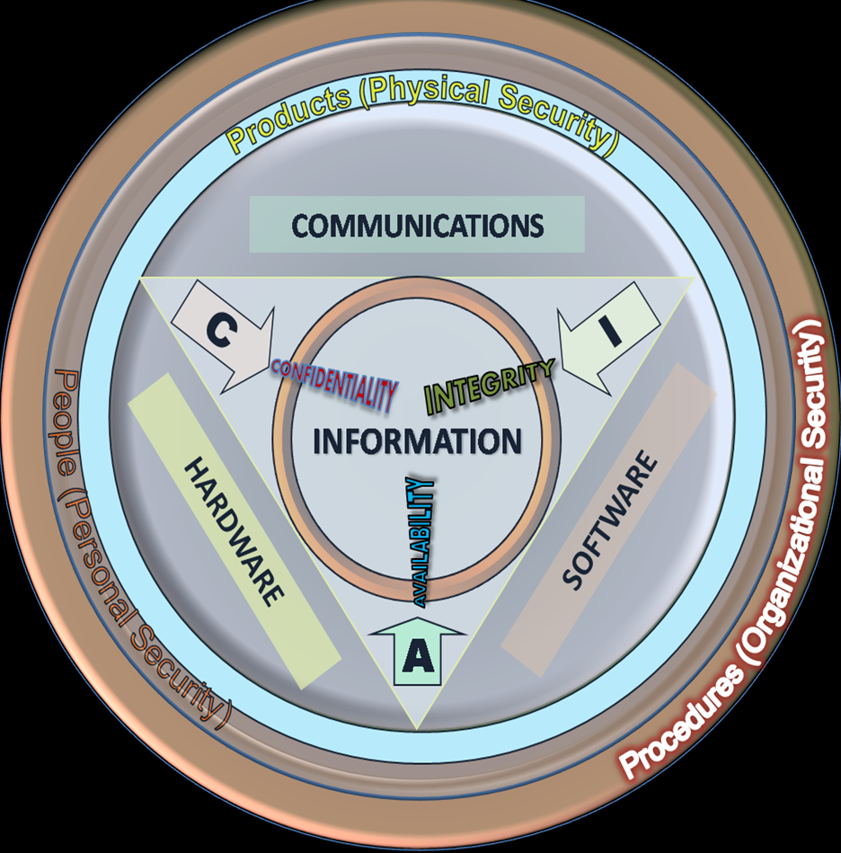

Slide 8
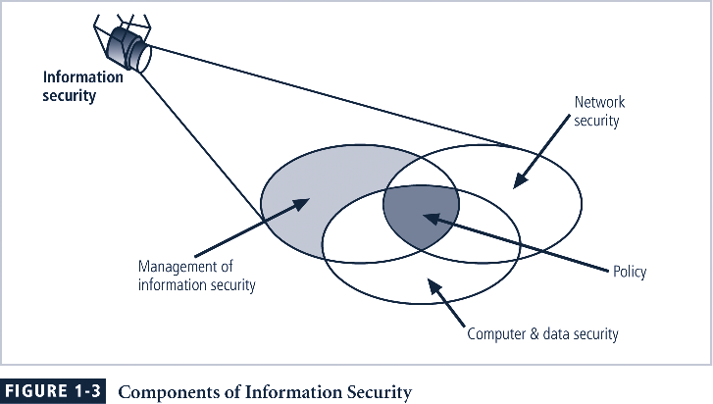
Components of Information Security

Slide 9
Critical Characteristics of Information
The value of information comes from the characteristics it possesses(Defined by CIA Triangle):
Availability : Enables authorized users or computers to access information without interference or obstruction and to receive it in the required format
Accuracy : When it is free from mistakes or errors and it has the value that user expects [Bank Balance]
Authenticity : The Quality or State of being genuine or Original, rather than a Reproduction or Fabrication [Email spoofing]
Notes:
Critical Characteristics Of Information
The value of information comes from the characteristics it possesses.
Availability - enables users who need to access information to do so without interference or obstruction and in the required format. The information is said to be available to an authorized user when and where needed and in the correct format.
Accuracy- the quality or state free from mistake or error and having the value that the end-user expects. If information contains a value different from the user’s expectations due to the intentional or unintentional modification of its content, it is no longer accurate.
Authenticity - the quality or state of being genuine or original, rather than a reproduction or fabrication. Information is authentic when it is the information that was originally created, placed, stored, or transferred.

Slide 10
Critical Characteristics of Information Contd…
Confidentiality : Prevented from the disclosure or exposure to unauthorized individuals or systems [bits & pieces of info / Salami theft]
Integrity : It is Whole, complete and uncorrupted [file hashing]
Utility : The quality or state of having value for some purpose or end
Possession: The quality or state of having ownership or control of some object or item
Notes:
Critical Characteristics Of Information contd…
Confidentiality - the quality or state of preventing disclosure or exposure to unauthorized individuals or systems.
Integrity - the quality or state of being whole, complete, and uncorrupted. The integrity of information is threatened when the information is exposed to corruption, damage, destruction, or other disruption of its authentic state.
Utility - the quality or state of having value for some purpose or end. Information has value when it serves a particular purpose. This means that if information is available, but not in a format meaningful to the end-user, it is not useful.
Possession - the quality or state of having ownership or control of some object or item. Information is said to be in possession if one obtains it, independent of format or other characteristic. While a breach of confidentiality always results in a breach of possession, a breach of possession does not always result in a breach of confidentiality.

Slide 11
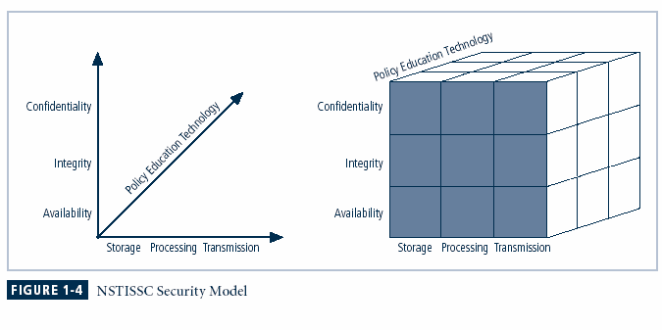
NSTISSC Security Model
National Security Telecommunications, and Information Systems Security Committee
Model for Information Security and is becoming Evaluation Standard
27 Cells representing areas that must be addressed n the security process
A control / safeguard that addresses the need to use Technology to protect the Integrity of information while in Storage
Notes:
This graphic informs the fundamental approach of the chapter and can be used to illustrate the intersection of information states (x-axis), key objectives of C.I.A. (y-axis) and the three primary means to implement (policy, education and technology).

Slide 12
Approaches to Information Security Implementation: Bottom-Up Approach
Grassroots effort: systems administrators attempt to improve security of their systems
Key advantage: technical expertise of individual administrators
Seldom works, as it lacks a number of critical features:
Participant support
Organizational staying power
Notes:
Bottom Up Approach To Security Implementation
Security can begin as a grass-roots effort when systems administrators attempt to improve the security of their systems. This is referred to as the bottom-up approach.
The key advantage of the bottom-up approach is the technical expertise of the individual administrators.
Unfortunately, this approach seldom works, as it lacks a number of critical features, such as participant support and organizational staying power.

Slide 13
Approaches to Information Security Implementation: Top-Down Approach
Initiated by upper management
Issue policy, procedures and processes
Dictate goals and expected outcomes of project
Determine accountability for each required action
The most successful also involve formal development strategy referred to as systems development life cycle
Notes:
Top-down Approach to Security Implementation
An alternative approach, which has a higher probability of success, is called the top-down approach. The project is initiated by upper management who issue policy, procedures and processes, dictate the goals and expected outcomes of the project, and determine who is accountable for each of the required actions.
The top-down approach has strong upper management support, a dedicated champion, dedicated funding, clear planning and the opportunity to influence organizational culture.
The most successful top-down approach also involves a formal development strategy referred to as a systems development life cycle.

Slide 14
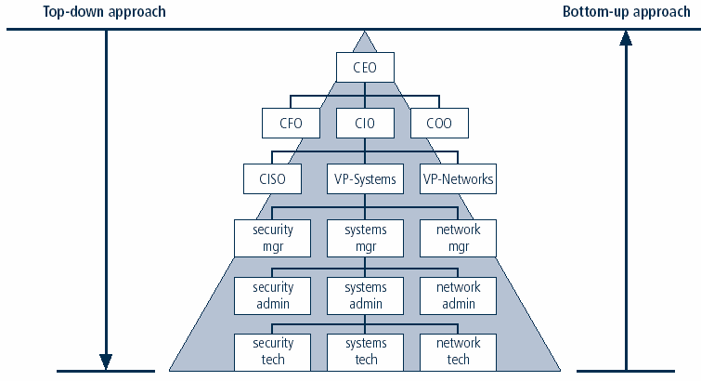
Approaches to Information Security Implementation Contd…
Notes:
Key concept here is the direction of the left and right side arrows to show where planning is sourced and from which direction the pressure for success if driven.

Slide 15
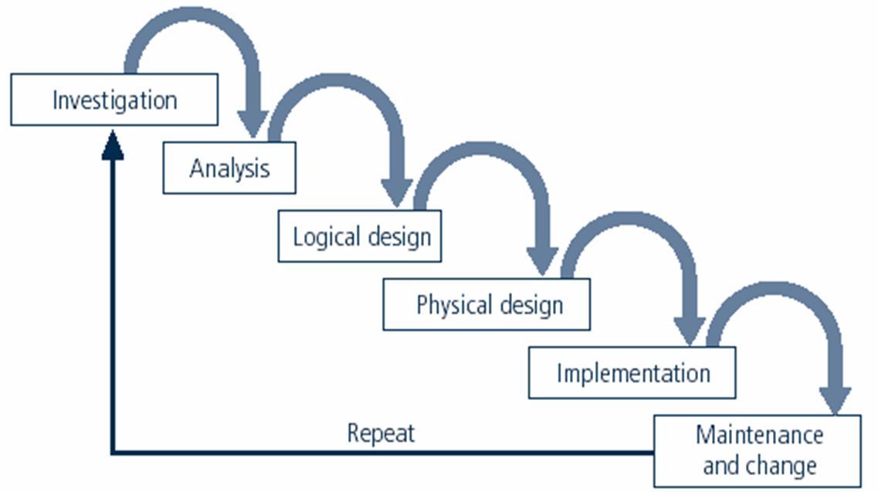
The Security Systems Development Life Cycle
The same phases used in traditional SDLC may be adapted to support specialized implementation of an IS project
Identification of specific threats and creating controls to counter them
SecSDLC is a coherent program rather than a series of random, seemingly unconnected actions
SDLC Waterfall Method
Notes:
The Security Systems Development Life Cycle
The same phases used in the traditional SDLC can be adapted to support the specialized implementation of a security project.
The fundamental process is the identification of specific threats and the creation of specific controls to counter those threats.
The SecSDLC unifies the process and makes it a coherent program rather than a series of random, seemingly unconnected actions.

Slide 16
Phase 1:Investigation
Management Identifies process, outcomes, goals, budget and constraints of the project
Begins with enterprise information security policy
Outline project scope and goals
Estimate cost
Organizational feasibility analysis is performed
Notes:
Investigation
The investigation of the SecSDLC begins with a directive from upper management, dictating the process, outcomes and goals of the project, as well as the constraints placed on the activity.
Frequently, this phase begins with a statement of program security policy that outlines the implementation of security.
Teams of responsible managers, employees and contractors are organized, problems analyzed, and scope defined, including goals objectives, and constraints not covered in the program policy.
Finally, an organizational feasibility analysis is performed to determine whether the organization has the resources and commitment necessary to conduct a successful security analysis and design.

Slide 17
Phase 2:Analysis
Documents from investigation phase are studied
Analyzes existing security policies or programs, along with documented current threats and associated controls
Study integration new system with existing system
Includes analysis of relevant legal issues that could impact design of the security solution
The risk management task begins
Notes:
Analysis
In the analysis phase, the documents from the investigation phase are studied.
The development team conducts a preliminary analysis of existing security policies or programs, along with documented current threats and associated controls.
This phase also includes an analysis of relevant legal issues that could impact the design of the security solution.
The risk management task - identifying, assessing and evaluating the levels of risk facing the organization, also begins in this stage.

Slide 18
Phase 3:Logical Design
Creates and develops blueprints for information security
Incident response actions planned:
Continuity planning
Incident response
Disaster recovery
Feasibility analysis to determine whether project should continue or be outsourced
Notes:
Logical Design
The logical design phase creates and develops the blueprints for security, and examines and implements key policies that influence later decisions.
Also at this stage, critical planning is developed for incident response actions to be taken in the event of partial or catastrophic loss.
Next, a feasibility analysis determines whether or not the project should continue or should be outsourced.
Physical Design
In the physical design phase, the security technology needed to support the blueprint outlined in the logical design is evaluated, alternative solutions generated, and a final design agreed upon.
The security blueprint may be revisited to keep it synchronized with the changes needed when the physical design is completed.
Criteria needed to determine the definition of successful solutions is also prepared during this phase.
Included at this time are the designs for physical security measures to support the proposed technological solutions.
At the end of this phase, a feasibility study should determine the readiness of the organization for the proposed project, and then the champion and users are presented with the design.
At this time, all parties involved have a chance to approve the project before implementation begins.

Slide 19
Phase 4:Physical Design
Needed security technology is evaluated, alternatives generated, and final design selected
Develop definition of successful solution
At end of phase, feasibility study determines readiness of the project Implementation

Slide 20
Phase 5:Implementation
Security solutions are acquired, tested, implemented, and tested again
Personnel issues evaluated; specific training and education programs conducted
Entire tested package is presented to management for final approval
Notes:
Implementation
The implementation phase is similar to the traditional SDLC.
The security solutions are acquired (made or bought), tested, and implemented, and tested again.
Personnel issues are evaluated and specific training and education programs conducted.
Finally, the entire tested package is presented to upper management for final approval.

Slide 21
Phase 6:Maintenance and Change
Perhaps the most important phase, given the ever-changing threat environment
Often, reparation and restoration of information is a constant duel with an unseen adversary
Information security profile of an organization requires constant adaptation as new threats emerge and old threats evolve
Notes:
Maintenance and Change
The maintenance and change phase, though last, is perhaps most important, given the high level of ingenuity in today’s threats.
The reparation and restoration of information is a constant duel with an often-unseen adversary.
As new threats emerge and old threats evolve, the information security profile of an organization requires constant adaptation to prevent threats from successfully penetrating sensitive data

Slide 22
Key Terms[Terminology]
Access-a subject or object’s ability to use, manipulate, modify, or affect another subject or object
Asset - the organizational resource that is being protected.
Attack - an act that is an intentional or unintentional attempt to cause damage or compromise to the information and/or the systems that support it.
Control, Safeguard or Countermeasure- security mechanisms, policies or procedures that can successfully counter attacks, reduce risk, resolve vulnerabilities, and otherwise improve the security within an organization
Exploit – to take advantage of weaknesses or vulnerability in a system
Exposure - a single instance of being open to damage.
Hacking - Good: to use computers or systems for enjoyment; Bad: to illegally gain access to a computer or system
Object - a passive entity in the information system that receives or contains information
Risk- the probability that something can happen.
Notes:
Key Terms
Access - a subject or object’s ability to use, manipulate, modify, or affect another subject or object.
Asset - the organizational resource that is being protected.
Attack - an act that is an intentional or unintentional attempt to cause damage or compromise to the information and/or the systems that support it.
Control, Safeguard or Countermeasure - security mechanisms, policies or procedures that can successfully counter attacks, reduce risk, resolve vulnerabilities, and otherwise improve the security within an organization.
Exploit – to take advantage of weaknesses or vulnerability in a system.
Exposure - a single instance of being open to damage.
Hack - Good: to use computers or systems for enjoyment; Bad: to illegally gain access to a computer or system.
Object - a passive entity in the information system that receives or contains information.
Risk - the probability that something can happen.

Slide 23
Key Terms[Terminology]
Security Blueprint - the plan for the implementation of new security measures in the organization
Security Model - a collection of specific security rules that represents the implementation of a security policy
Security Posture or Security Profile- a general label for the combination of all policy, procedures, technology, and programs that make up the total security effort currently in place
Subject - an active entity that interacts with an information system and causes information to move through the system for a specific end purpose
Threats - a category of objects, persons, or other entities that represents a potential danger to an asset.
Threat Agent -a specific instance or component of a more general threat
Vulnerability- weaknesses or faults in a system or protection mechanism that expose information to attack or damage
Notes:
Key Terms
Security Blueprint - the plan for the implementation of new security measures in the organization.
Security Model - a collection of specific security rules that represents the implementation of a security policy.
Security Posture or Security Profile - a general label for the combination of all policy, procedures, technology, and programs that make up the total security effort currently in place.
Subject - an active entity that interacts with an information system and causes information to move through the system for a specific end purpose
Threats - a category of objects, persons, or other entities that represents a potential danger to an asset.
Threat Agent - a specific instance or component of a more general threat.
Vulnerability - weaknesses or faults in a system or protection mechanism that expose information to attack or damage.

Slide 24
Summary
Information security is a “well-informed sense of assurance that the information risks and controls are in balance.”
Computer security began immediately after first mainframes were developed
Successful organizations have multiple layers of security in place: physical, personal, operations, communications, network, and information.
Security should be considered a balance between protection and availability
Information security must be managed similar to any major system implemented in an organization using a methodology like SecSDLC

